Slide 1
Operating
Operating

Slide 2
OPERATING
Always listen before calling and ask if the frequency is in use.
(a local station may be in contact with a distant station which you cannot hear)

Slide 3
CQ Calls
A CQ call is a general call to any amateur who may be listening.
It is an invitation to start a conversation.

Slide 4
CQ Calls (VHF FM)
Use short call e.g.
“CQ CQ CQ from M0ABC Mike Zero Alpha Bravo Charlie”
Repeat only after a reasonable pause. (30 seconds ?)

Slide 5
CQ Calls (SSB)
Use longer call to allow receiving station to tune in e.g.
“CQ CQ CQ from M0ABC CQ Mike Zero Alpha Bravo Charlie”
Sent three or four times.
Short pauses (3 seconds) between transmissions are acceptable.

Slide 6
Change Frequency - 1
If calling CQ on a calling channel (e.g. 145.500 MHz) you must change frequency as soon as contact is established.
Calling channels should be kept clear at all other times.

Slide 7
Change Frequency - 2
An alternative to a specific calling frequency, some channels are specified as “centres of activity”.
e.g. 144.300 MHz is the allocated centre of activity for SSB voice. You can expect to find SSB signals from approximately 144.265 to 144.335 MHz.

Slide 8
Reply to CQ call
If replying to a CQ call it is usual practice to reply on the same frequency.

Slide 9
Split Frequency
Sometimes, if a lot of people reply to a CQ call, the CQ station will say “listening five up” meaning “listening 5 kHz up.” This is called “split frequency” which helps ‘spread out’ the signals.

Slide 10
Contests - 1
Contests are very popular and are sometimes referred to as “Sport Radio”.
Contests usually require an exchange of information e.g. signal report, serial number and location.

Slide 11
Contests - 2
Contests often have sections for different bands, power levels, modes.

Slide 12
Contests - 3
Contests can run from as little as two hours to two days.
Points can be awarded for:
number of contacts
countries/continents
distances

Slide 13
Awards
Achievement awards are available for working:
Continents, countries, islands, prefixes and locator squares.
Variations may include frequency bands or low power.

Slide 14
Logs & Records - 1
A record of transmissions and stations worked can be useful to:
check for transmission times in case of an interference issue
keep a list of callsigns, names and locations
compare signal quality against previous contacts

Slide 15
Logs & Records - 2
An individual log should contain:
Date, time (UTC), callsign of station worked, mode, frequency, power output

Slide 16
Spectrum Abuse - 1
Transmission of music and the use of offensive or threatening language are unacceptable in amateur radio.

Slide 17
Spectrum Abuse - 2
The response to unacceptable behaviour is simple –
IGNORE IT

Slide 18
Spectrum Abuse - 3
Licence Clause 11(2): “you shall only talk to other radio amateurs”
If you talk to anyone who does not give a callsign, you are committing a criminal offence !
You could be fined, lose your licence and equipment and get a criminal record!

Slide 19
Band Plans

Slide 20
Band Plans - 1
WHY?
Transmission modes
- Voice (Single Sideband)
- Voice (Frequency Modulation)
- Morse code
- Data etc
do not mix well – so separate
sub-bands are allocated

Slide 21
Band Plans - 2
The International Amateur Radio Union (IARU) produce the band plans and the RSGB publish 24 band plans for the UK.
You only need to know about TWO for the exam:
14 MHz (twenty metres)
144 MHz (two metres)
(Both plans given in exam)

Slide 22
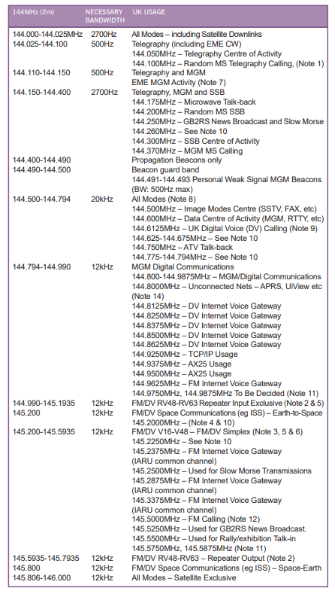
Band Plan – 144 MHz

Slide 23
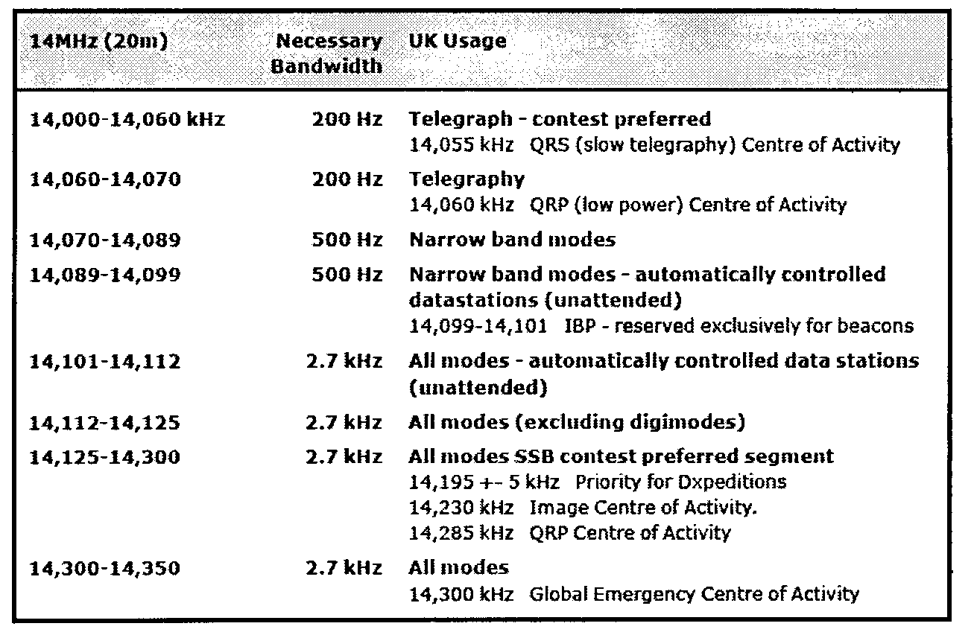
Band Plan – 14 MHz

Slide 24
Band Plans Notes - 1
1. Narrow band modes eg CW (Morse code) and data tend to be at the lower end of the bands.
2. Lower sideband (LSB) is normally used below 10 MHz and Upper sideband (USB) above 10 MHz. One important exception is that you MUST use USB in the 5 MHz band (the frequencies are shared with the UK military and the military only use USB).

Slide 25
Band Plans Notes - 2
Note that band plans in other countries and IARU regions may not align with the UK band plans e.g. the UK (IARU Region 1) 40 metre band extends from 7.0 to 7.2 MHz but in the USA (IARU Region 2), the band is 7.0 to 7.3 MHz and hence America has a different band plan.

Slide 26
Band Plans Notes - 3
3. Transmission on beacon frequencies must be avoided.
4. SSB (voice) operation should not be used on the 10 MHz (30 metre band) because it is only 50 kHz wide.

Slide 27
Band Plans Notes - 4
5. Contests shall NOT be organised in the 5 MHz, 10 MHz, 18 MHz and 24 MHz bands.
6. Transmissions on satellite frequencies should be avoided for terrestrial contacts.

Slide 28
Band Plans Notes – 5
The RF spectrum is allocated to many other users. Even some amateur bands are shared with other organisations eg our seventy centimetre band (430-440 MHz) is shared with the Ministry of Defence.

Slide 29
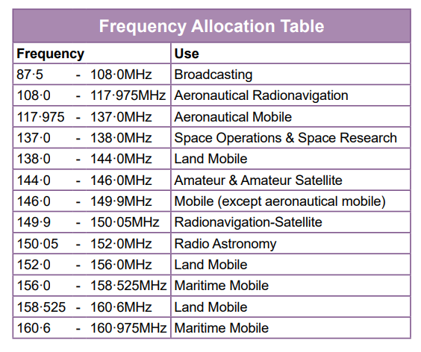
Band Plans – Other Users
A portion of the VHF spectrum

Slide 30
Codes & Abbreviations

Slide 31
Phonetic Alphabet A-N
A Alpha B Bravo
C Charlie D Delta
E Echo F Foxtrot
G Golf H Hotel
I India J Juliet
K Kilo L Lima
M Mike N November

Slide 32
Phonetic Alphabet O-Z
O Oscar P Papa
Q Quebec R Romeo
S Sierra T Tango
U Uniform V Victor
W Whisky X X-ray
Y Yankee Z Zulu
Learn & remember !!

Slide 33
WHY Q codes - 1
Original use was to speed up Morse Code contacts.
Morse is quite slow – usually < 20 wpm
(speech is at least 200 words per minute).
Q codes are often used in voice contacts because they are international.

Slide 34
WHY Q codes - 2
For Example - QTH means
“location” in English
“emplacement” in French
“el lugar” in Spanish

Slide 35
Q codes
Memorise the following ten codes:
QRM QRN
QRP QRT
QRZ QSB
QSL QSO
QSY QTH

Slide 36
Q codes - 1
QRM Interference from other stations
(think M = Man-made)
QRN Interference from static eg thunder storms
(think N = Natural)

Slide 37
Q codes - 2
QRP Low Power (e.g. 5 Watts)
QRT Closing down
QRZ Who is calling?
QSB Fading (Signals varying in strength)

Slide 38
Q codes - 3
QSL Confirmation
QSO Contact (i.e. conversation with a station)
QSY Change frequency
QTH Location

Slide 39
Abbreviations
Memorise the following:
CQ - general call
CW - Morse code (Continuous or Carrier Wave)
DE - from
DX - long distance
R - Received (hence “ROGER” from old phonetic alphabet)
RST - Readability, Signal Strength & Tone report
SIG - Signal
UR - Your
WX - Weather
Why??
Quicker Morse code and Internationally recognised
Notes:
No such thing as and Advanced Licence – take advanced EXAM to get FULL licence

Slide 40
RST Reports
Readability 1 to 5
Strength 1 to 9
Tone 1 to 9
The higher the figure, the better the signal

Slide 41
Readability code
1 - unreadable
2 - barely readable
3 - readable with difficulty
4 - readable with a little difficulty
5 - totally readable
Note – only FIVE levels

Slide 42
Signal Strength code
1 - faint, barely perceptible
2 - very weak
3 - weak
4 - fair
5 - fairly good
6 - good
7 - moderately strong
8 - strong
9 - very strong
NINE levels
Notes:
No such thing as and Advanced Licence – take advanced EXAM to get FULL licence

Slide 43
Tone code
Only used for CW (Morse) and other digital modes eg RTTY
1 - extremely rough note
2 - very rough note
3 - rough note
4 - fairly rough note
5 - note modulated with strong ripple
6 - modulated note
7 - near DC note with small ripple
8 - good note with trace of ripple
9 - pure note
NINE levels
Notes:
No such thing as and Advanced Licence – take advanced EXAM to get FULL licence

Slide 44
RS Examples
5 & 9 Totally readable & very strong
3 & 7 Readable with difficulty
and moderately strong
2 & 3 Barely readable and weak
1 & 9 Unreadable but very strong
(microphone fault ?)
Notes:
No such thing as and Advanced Licence – take advanced EXAM to get FULL licence

Slide 45
RST Examples
599 Totally readable
very strong
pure note
333 Readable with difficulty
weak signal
rough note
Notes:
No such thing as and Advanced Licence – take advanced EXAM to get FULL licence

Slide 46
Common Modes
CW – Morse code - can get through when other modes e.g. SSB, fail
SSB – best for HF phone operation
FM - easiest to tune in and listen to (rarely used below 28 MHz)
Notes:
Some pre-war 2 letter G callsigns

Slide 47
Some Other Modes
PSK & RTTY – common ‘digital’ modes
FT8 – weak signal digital mode
FSTV – full definition television (> 1240 MHz)
SSTV – slow scan television (HF & VHF)

Slide 48
Computers
Many modes e.g. RTTY, PSK, SSTV,
CW (morse code) can be sent and received using a personal computer connected to the transceiver.

Slide 49
Callsign directories
RSGB year book & CD (Europe)
www.qrz.com (worldwide)

Slide 50
Country prefixes
Memorise the following:
EI Ireland F France
I Italy JA Japan
VE Canada PA Netherlands
VK Australia W USA
ZL New Zealand

Slide 51
QSL cards
Postcards sent to confirm a contact
Often used to claim awards
Usually sent via “bureau” to avoid postage
Most now sent via internet

Slide 52
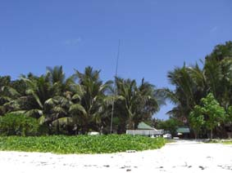
Dx-peditions

Slide 53
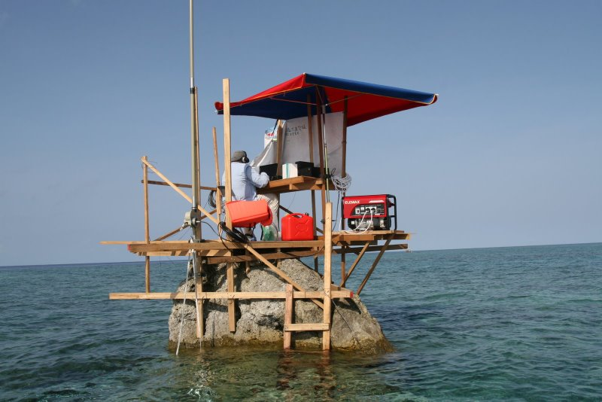
Dx-peditions

Slide 54
Repeaters

Slide 55
Repeaters
A repeater is an automatic relay station usually on a hill or high building.
Used to improve the range of mobile & hand portable stations.

Slide 56
Mobile/Portable problems
Antennas only few feet above ground
Often low power e.g. 4 Watts or less
Moving among buildings, trees, hills
Result – very short range

Slide 57
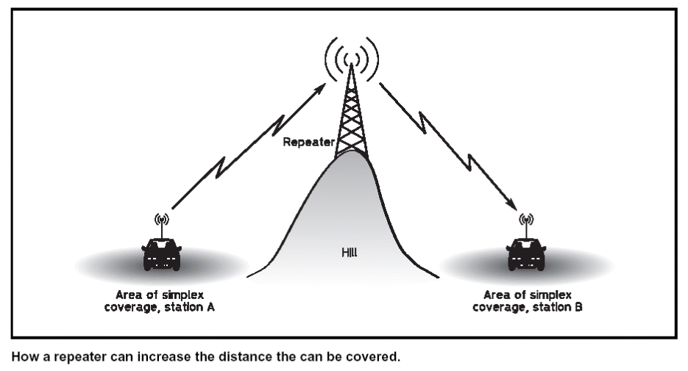
Problem – short range

Slide 58
Solution – A Repeater

Slide 59
Repeaters - Map
300 +

Slide 60
Repeater Technical Issues - 1
Most repeaters have to transmit and receive at the SAME time, from the same location and often using the same antenna
Therefore they must receive and transmit on DIFFERENT frequencies.

Slide 61
Repeater Technical Issues - 2
On 2 metres (144 MHz) the frequency offset is 0.6 MHz eg GB3VA receives on 145.1 MHz and transmits on 145.7 MHz.
On 70 cms (430 MHz) the offset is 1.6, 7.6 or 9.0 MHz e.g. GB3HR receives on 434.95 MHz and transmits on 433.35 MHz.
Do NOT operate simplex transmissions on repeater input or output frequencies.

Slide 62
Repeater Technical Issues - 3
We need a system to control when a repeater re-transmits
CTCSS – continuous tone
Nine frequencies are used by amateurs in UK: 67.1 Hz 71.9 Hz 77.0 Hz 82.5 Hz 88.5 Hz 94.8 Hz 103.9 Hz 110.9 Hz 118.8 Hz

Slide 63
Repeater Technical Issues - 4
Some repeaters have a transmit time-out e.g. 2 minutes.
Such repeaters often have a “reset” facility where a half second burst of tone will restart the 2 minute timer.

Slide 64
Special Event Stations
A Special Event Station (SES) is set up to commemorate a specific event.
The station MUST be open to the public.
Any FULL licensee can apply (via Ofcom) for a “Notice of Variation” (NoV) to obtain a special callsign. Such licences are valid for a maximum of 28 days.

Slide 65
SES Callsigns
Callsigns begin with GB or MB followed by a digit (0 to 8) and then two or three letters e.g.
GB0PPY – Remembrance (Poppy) day
MB5GF – Guy Fawkes, November 5th
The regional identifier (M, W, D etc) is not used in an SES callsign.

Slide 66
Digital Modes
In addition to analogue voice and Morse code there are now many digital modes in use.
Some convert analogue speech into digital streams (DV) and others encode text or images into data streams (DD).
The different systems may not be compatible and may need appropriate equipment eg DMR, Fusion and D-Star are all different DV systems.

Slide 67
Digital Modes - Equipment
Some DV equipment embeds a callsign into the data and, for the purposes of radio identification, this MUST be the same as the operator’s.
If you borrow such equipment you must reset the embedded callsign.

Slide 68
Digital Equipment- Operating
Users of DV equipment should check that a channel is not in use by another mode before transmitting.
Similarly, FM operators should check that the channel is not in use by other modes.
However, such checks are not 100% reliable.

Slide 69
Digital Equipment- Computers -1
Several types of transmissions can be generated and received with the aid of a personal computer and suitable interface.
Quite often the “interface” is little more than a few resistors and possibly two small audio transformers. The object is to connect the computer soundcard output to the transmitter microphone socket and the loudspeaker of the receiver into the soundcard line input.

Slide 70
Digital Equipment- Computers -2
It is important to get the audio levels, to and from the transceiver correct.
Beware that computers can generate warning “bleeps.” This should be disabled to prevent unwanted transmissions.

Slide 71
Satellites

Slide 72
Satellites - Doppler
Satellites orbit the Earth at heights above 250 km and travel at 17,000 mph.
Such high speed causes signals to
shift in frequency – a few kHz up or down (Doppler shift).

Slide 73
Satellites – uplink & downlink
Most satellites orbit earth in about 90 minutes.
Only in range for 10 minutes each “pass”.
Uplink & downlink frequencies are always in
different bands e.g. 144 & 432 MHz.
You MUST be able to receive on BOTH uplink
and downlink frequencies.

Slide 74
Satellites – frequencies
Satellites use fairly narrow specific sections of the amateur bands.
Terrestrial contacts should not use satellite frequencies.

Slide 75
Satellites - power
Satellites have limited power supplies.
You only need a few Watts to communicate via a satellite.
Excessive uplink power can reduce signal
strength of other users and may cause the satellite to shut down.

Slide 76
Operating - End

