Slide 1
Licence Regulations
Licence Regulations

Slide 2
Nature of Amateur Radio
For self-training in radio communication
Non-commercial
No business use
No commercial advertising

Slide 3
Where?
We are allowed to transmit anywhere in and over the UK, Channel Islands and the Isle of Man – including territorial seas. “OVER” includes in aircraft
Such ships or aircraft must be registered in UK, Channel islands and Isle of Man.

Slide 4
Where?
The licensee can only operate from a ship or aircraft with the agreement of the captain or the person who is control.
See the frequency schedule for the permitted bands and power levels when transmitting from an aircraft.

Slide 5
Privileges - 1
Full licensees have various privileges which are not available to Foundation and Intermediate licensees.
eg Foundation/Intermediate licensees are not permitted to use some frequencies such as the 5MHz band.

Slide 6
Privileges - 2
Full licensees can operate in many countries where there is a reciprocal agreement and in other countries, mostly in Europe, which have a CEPT agreement.

Slide 7
Ofcom - 1
The Office of Communications is the UK regulatory body for Amateur Radio.

Slide 8
Ofcom - 2
You must immediately inform Ofcom if you change your name, main station address or mailing address.

Slide 9
Ofcom - 3
Ofcom can revoke your licence if you
contravene the licence regulations
fail to advise a change of name or address
fail to revalidate your details (at least once every five years)

Slide 10
UK Licence Classes
Foundation
Intermediate
Full

Slide 11
Callsign Formats
(in England)
Foundation M3ABC M6ABC M7ABC
Intermediate 2E0ABC 2E1ABC
Full M0ABC M1ABC M5ABC G0ABC, G1ABC to G8ABC
Note: The 0 above is a Zero (not the letter O)

Slide 12
Regional Secondary Locators
Secondary Identifiers (E, W, I, D, J, U, M) are used to indicate which country the station is transmitting from but which is not necessarily the main (home) station location.
Such identifiers eg MW0ABC, are optional for Foundation and Full callsigns but are COMPULSORY for Intermediate callsigns which begin with the figure 2 (ITU regulations state that if the callsign begins with a number, the next character MUST be a letter)

Slide 13
Regional Secondary Locators
Secondary Identifiers (E, W, I, D, J, U, M)
Full Foundation
England ME0ABC ME7ABC
Wales MW0ABC MW7ABC
N. Ireland MI0ABC MI7ABC
Isle of Man MD0ABC MD7ABC
Jersey MJ0ABC MJ7ABC
Guernsey MU0ABC MU7ABC
Scotland MM0ABC MM7ABC

Slide 14
Regional Secondary Locators (RSL)
Intermediate – (COMPULSORY ! )
England 2E0ABC 2W1ABC
Wales 2W0ABC 2W1ABC
N. Ireland 2I0ABC 2I1ABC
Isle of Man 2D0ABC 2D1ABC
Jersey 2J0ABC 2J1ABC
Guernsey 2U0ABC 2U1ABC
Scotland 2M0ABC 2M1ABC

Slide 15
Callsign Suffixes
Any suffix can be added to a callsign by adding a ‘slash’ or ‘stroke’ symbol. Such suffixes must not be offensive or obscure the correct identification.
eg G3EFX/M - often used when driving
G3EFX/SCOUTS

Slide 16
Callsign – When ?
You must give your callsign CLEARLY AT ALL TIMES
Your callsign must be transmitted AS FREQUENTLY AS
IS PRACTICABLE during transmissions
The callsign must be given by VOICE or other APPROPRIATE FORMAT consistent with the mode
of operation
It is good practice to give your callsign more often
eg at the end of each “over”.

Slide 17
Identification
Identification (your callsign) should be given
During the initial transmission
Change of frequency
Change of mode eg FM to SSB
Change of operator (unless under supervision)
Change of supervisor
Change of RSL – if used

Slide 18
Operators & Supervision
Only the licensee, or any other person operating under the licensee’s direct supervision, may use the radio equipment and the licensee’s callsign. The operator must comply with the licence regulations.

Slide 19
Radio Equipment
In the licence document , the term Radio Equipment (capital R and capital E) means the actual physical equipment (transmitter, receiver etc) AND THE CALLSIGN
This means that all transmissions can be clearly identified.

Slide 20
User Services
Under certain circumstances* you may allow a member of a “User Service” eg Police, Fire, Ambulance etc to use your equipment.
*emergencies or rehearsals for
potential emergencies

Slide 21
Messages - 1
Messages (eg conversations) can ONLY be sent to other radio amateurs or to the stations of other amateurs.
Such messages must be in plain language unless a User Service wishes to obscure the message to retain confidentiality

Slide 22
Messages - 2
In an international disaster:
- messages may be passed, internationally,
on behalf of non-licensed persons
- non-amateur stations involved in disaster
communications may be heard on
amateur frequencies.

Slide 23
Messages - 3
Conversations can be established between three or more stations as long as contact is confirmed (ie callsign exchange) with at least one member of the group. Such groups are known as “networks” or “nets”.

Slide 24
Messages - 4
UK amateurs may receive amateur signals on non-UK frequencies but must reply on UK frequencies.
For example, amateurs in the Americas are allocated frequencies between 7.0 and 7.3 MHz but the UK allocation is only 7.0 to 7.2 MHz.

Slide 25
Messages - 5
People of all ages and backgrounds participate in amateur radio so messages must NOT cause offence

Slide 26
Messages - 6
Public codes and common abbreviations eg Morse code and the Q-code are permitted but encryption which is used to deliberately obscure a message is not allowed.
(User Services may encrypt messages)

Slide 27
Transmitters - design
Transmitters must be designed, constructed, maintained and used so that their use does not cause any Undue Interference to any wireless telegraphy.
Notes:
Some pre-war 2 letter G callsigns

Slide 28
Transmitters – clean & stable
Transmitters need to have a clean output eg minimum harmonic or spurious emissions.
Transmissions should be frequency stable
Notes:
Some pre-war 2 letter G callsigns

Slide 29
Transmitters - bandwidth
Transmitted bandwidth should be kept to a minimum
no more than 1% of the mean power of the transmission should fall outside of the nominal modulated carrier bandwidth
Notes:
Some pre-war 2 letter G callsigns

Slide 30
Transmitters - tests
Licensees need to conduct tests from time to time to ensure that the station is not causing any Undue Interference to other radio users.
Notes:
Some pre-war 2 letter G callsigns

Slide 31
Receivers
The station must have equipment for the reception of messages on all frequencies and modes in use for transmissions

Slide 32
Ofcom & BBC - 1
If an interference problem, to domestic radio or TV, cannot be resolved locally, the first contact is the BBC. If the BBC cannot solve the problem, they will involve Ofcom.
Notes:
No such thing as and Advanced Licence – take advanced EXAM to get FULL licence

Slide 33
Ofcom & BBC - 2
If Ofcom are called in to investigate an interference problem they can:
Request that you keep a log
Request modification to the equipment
Limit the transmit power
Prohibit operation during certain hours
Notes:
No such thing as and Advanced Licence – take advanced EXAM to get FULL licence

Slide 34
Ofcom
Ofcom can:
Inspect your station
Require modification
Restrict operation
Close down your station

Slide 35
Remote Operation
You may use any type of communication (radio, telephone, internet etc) for control of the main station.
The control link must be adequately secure so that no other person can operate the remote equipment
Notes:
Some pre-war 2 letter G callsigns

Slide 36
Remote control via Radio
If remote control is via an amateur radio frequency, the link must conform to the licence regulations and should be above 30 MHz.
Links must NOT be encrypted.
Notes:
Some pre-war 2 letter G callsigns

Slide 37
CEPT & International
CEPT – Conference European of Postal and Telecommunications.
An agreement between many countries (mostly European) whereby UK Full licensee amateurs can operate abroad.
The two important sections are:
T/R 61-01 and T/R 61-02

Slide 38
CEPT T/R 61-01
T/R 61-01 allows UK Full licensees to operate in CEPT counties for SHORT visits eg holidays.

Slide 39
CEPT T/R 61-02
T/R 61-02 allows UK Full licensees to operate in CEPT counties for LONGER visits by applying for a local licence under the Harmonised Amateur Radio Examination Certificate (HAREC) scheme.

Slide 40
CEPT - Rules
When operating under a CEPT arrangement, amateurs must abide by the local licence regulations.

Slide 41
CEPT
The CEPT facility does NOT extend to Reciprocal or club licences.

Slide 42
HAREC Certificate - 1
In the UK, when a candidate passes the Full exam (via the Foundation-Intermediate-Full or Direct-to-Full route), the RSGB will provide a HAREC certificate.

Slide 43
HAREC Certificate - 2
T/R 61-02 allows HAREC certificate holders to apply for a top level license in a CEPT country.

Slide 44
Reciprocal Licences
Many countries, (including non-CEPT) will offer reciprocal licences to UK amateurs who have a HAREC Full licence.
Such operation must be in accordance with the host country’s rules.

Slide 45
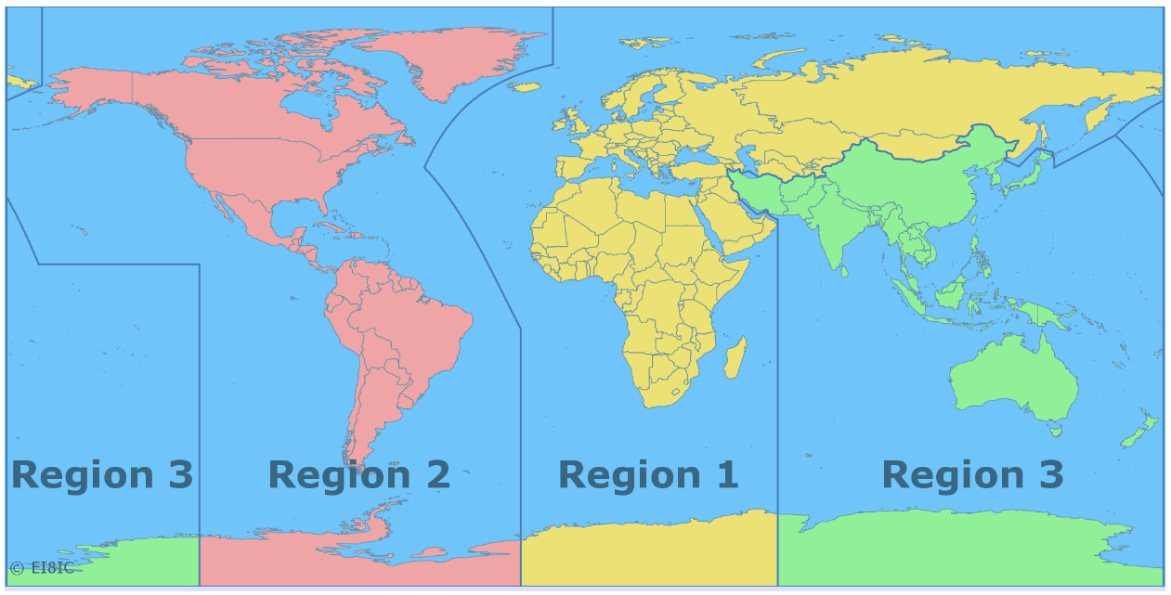
ITU Amateur Regions

Slide 46
EMF
ELECTROMAGNETIC FIELD
Since 2021, Ofcom have required radio amateurs to assess their station to ensure that members of the general public are not subjected to unsafe levels of RF radiation.

Slide 47
EMF levels - 1
There are two levels which must not be exceeded:
An average limit - any higher may cause thermal heating (max 10 Watts eirp)
A peak limit - any higher may cause nerve stimulation (max 100 Watts eirp)

Slide 48
EMF levels - 2
Limits are defined by the International Committee on Non-Ionising Radiation Protection (ICNIRP).

Slide 49
EMF Levels - 3
If the transmitted power level is less that 10 Watts EIRP average and less than 100 Watts EIRP peak then the RF fields are considered to be safe. If either is above these limits then it will be necessary to assess the system to determine the exclusion zone.
The details of the assessment, including a “below 10/100 Watts EIRP” statement need to be recorded (written or digital)

Slide 50
EMF – who
With two exceptions, the term “general public” means ANYONE who may come in range of the RF radiation. The only people it does not apply to are:
Radio amateurs (they are expected to appreciate the risk of being near a transmitting antenna).
Contract workers (their employer is expected to know the risks)

Slide 51
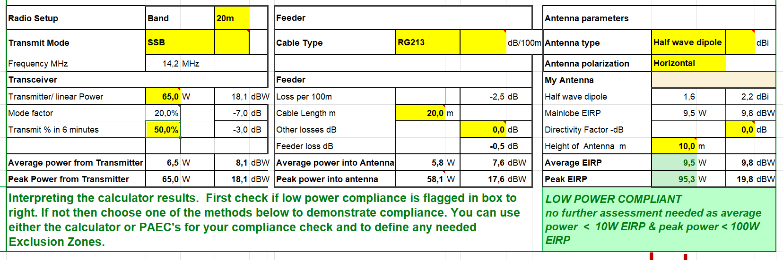
EMF – Assessment
Ofcom and RSGB provide spreadsheets to assess each band/arrangement. Here is a sample of the RSGB form:

Slide 52
Exclusion Zone
This is the area where the RF levels exceed the permitted levels and where members of the general public could be expected to use

Slide 53
EMF – System Changes
If the transmitted power level or any part of the antenna is changed then the assessment must be repeated and recorded.

Slide 54
EMF – Emergencies
In the case of using the radio station to assist in an emergency operation, it is NOT necessary to perform an EMF assessment.

Slide 55
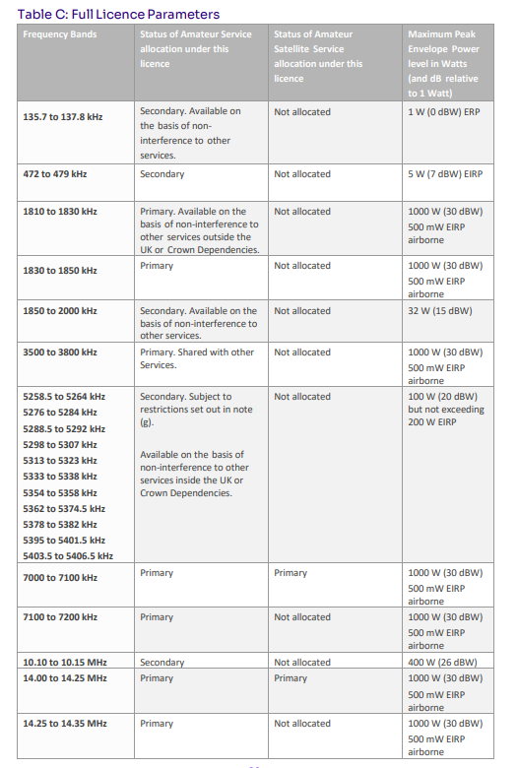
Frequency Schedule part 1

Slide 56
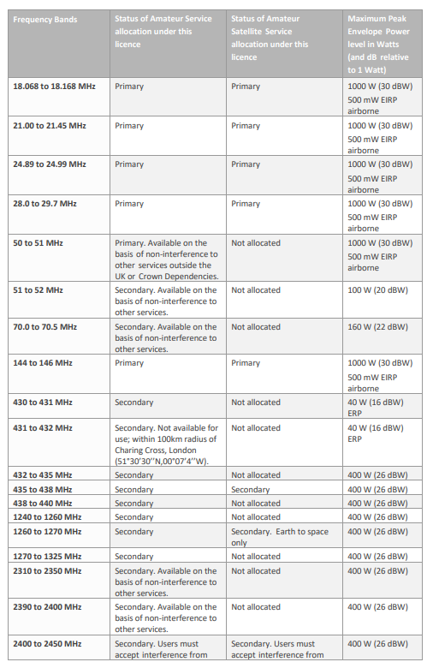
Frequency Schedule part 2

Slide 57
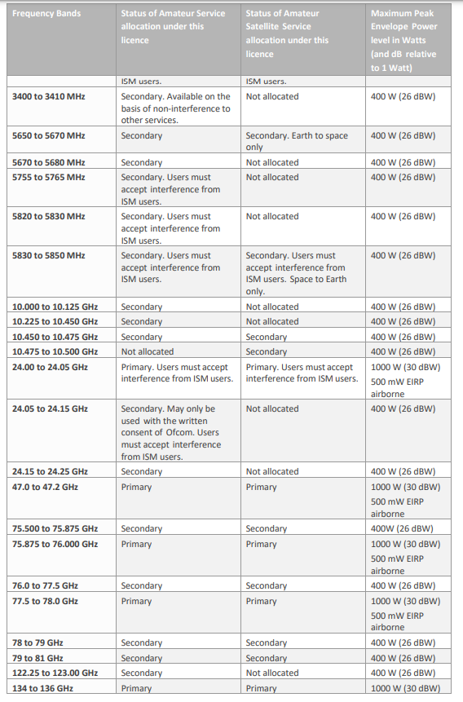
Frequency Schedule part 3

Slide 58
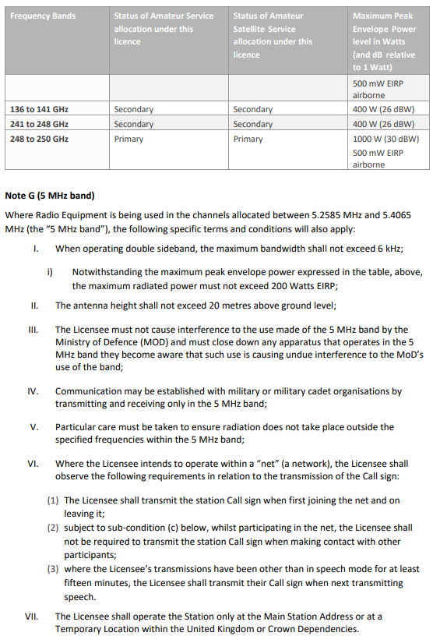
Frequency Schedule part 4

Slide 59
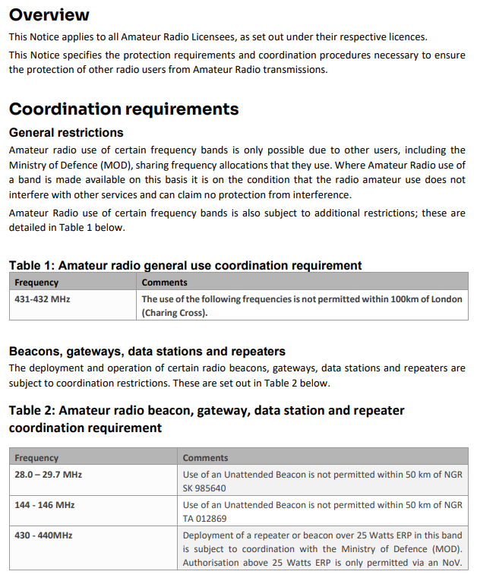
Notice of Coordination -1

Slide 60
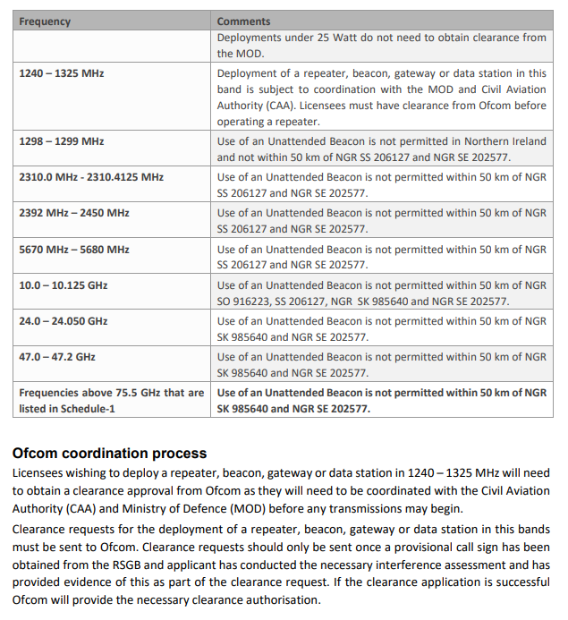
Notice of Coordination - 2

Slide 61
Licence Regulations
END

