Slide 1
Operating
Operating

Slide 2
OPERATING
Always listen before calling and ask if the frequency is in use.
(a local station may be in contact with a distant station which you cannot hear)

Slide 3
CQ Calls
A CQ call is a general call to any amateur who may be listening.
It is an invitation to start a conversation.

Slide 4
Reply to CQ call
If replying to a CQ call it is usual practice to reply on the same frequency.

Slide 5
CQ Calls (SSB)
Use longer call to allow receiving station to tune in eg
“CQ CQ CQ from M0ABC CQ
Mike Zero Alpha Bravo Charlie”
Sent three or four times.
Short pauses (3 seconds) between transmissions are acceptable.

Slide 6
CQ Calls (VHF FM)
Use short call eg
“CQ CQ CQ from M0ABC Mike Zero Alpha Bravo Charlie”
Repeat only after a reasonable pause. (30 seconds ?)

Slide 7
Change Frequency - 1
If calling CQ on a calling channel (eg 145.500 MHz) you must change frequency as soon as contact is established.
Calling channels should be kept clear at all other times.

Slide 8
Split Frequency
Sometimes, if a lot of people reply to a CQ call, the CQ station will say “listening five up” meaning “listening 5 kHz up.” This is called “split frequency” which helps ‘spread out’ the signals.

Slide 9
Change Frequency - 2
An alternative to a specific calling frequency, some channels are specified as “centres of activity”.
eg 144.300 MHz is the allocated centre of activity for SSB voice. You can expect to find SSB signals from approximately 144.265 to 144.335 MHz.

Slide 10
Country prefixes
Memorise the following:
W USA F France
I Italy JA Japan
VE Canada PA Netherlands
VK Australia ZL New Zealand
EI Republic of Ireland

Slide 11
WHY Q codes - 1
Original use was to speed up Morse Code contacts.
Morse is quite slow – usually < 20 wpm
(speech is at least 200 words per minute).
Q codes are often used in voice contacts
because they are international.

Slide 12
WHY Q codes - 2
For Example - QTH means
“location” in English
“emplacement” in French
“el lugar” in Spanish

Slide 13
Q codes
Memorise the following ten codes:
QRM QRN
QRP QRT
QRZ QSB
QSL QSO
QSY QTH

Slide 14
Q codes - 1
QRM Interference from other stations
(think M = Man-made)
QRN Interference from static eg thunder storms
(think N = Natural)

Slide 15
Q codes - 2
QRP Low Power (eg 5 Watts)
QRT Closing down
QRZ Who is calling?
QSB Fading (Signals varying in strength)

Slide 16
Q codes - 3
QSL Confirmation
QSO Contact (ie conversation with a station)
QSY Change frequency
QTH Location

Slide 17
RST Reports
Readability 1 to 5
Strength 1 to 9
Tone 1 to 9
The higher the figure, the better the signal

Slide 18
Readability code
1 - unreadable
2 - barely readable
3 - readable with difficulty
4 - readable with a little difficulty
5 - totally readable
Note – only FIVE levels

Slide 19
Signal Strength code
1 - faint, barely perceptible
2 - very weak
3 - weak
4 - fair
5 - fairly good
6 - good
7 - moderately strong
8 - strong
9 - very strong
NINE levels
Notes:
No such thing as and Advanced Licence – take advanced EXAM to get FULL licence

Slide 20
Tone code
Only used for CW (Morse) and other digital
modes eg RTTY
1 - extremely rough note
2 - very rough note
3 - rough note
4 - fairly rough note
5 - note modulated with strong ripple
6 - modulated note
7 - near DC note with small ripple
8 - good note with trace of ripple
9 - pure note
NINE levels
Notes:
No such thing as and Advanced Licence – take advanced EXAM to get FULL licence

Slide 21
RS Examples
5 & 9 Totally readable & very strong
3 & 7 Readable with difficulty
and moderately strong
2 & 3 Barely readable and weak
1 & 9 Unreadable but very strong
(microphone fault ?)
Notes:
No such thing as and Advanced Licence – take advanced EXAM to get FULL licence

Slide 22
RST Examples
599 Totally readable
very strong
pure note
333 Readable with difficulty
weak signal
rough note
Notes:
No such thing as and Advanced Licence – take advanced EXAM to get FULL licence

Slide 23
Logs & Records - 1
A record of transmissions and stations worked can be useful to:
check for transmission times in case of an interference issue
keep a list of callsigns, names and locations
compare signal quality against previous contacts

Slide 24
Logs & Records - 2
An individual log should contain:
Date, time (UTC), callsign of station worked, mode, frequency, power output

Slide 25
Contests - 1
Contests are very popular and are sometimes referred to as “Sport Radio”.

Slide 26
Contests - 2
Contests can run from as little as two hours to two days.
Points can be awarded for:
number of contacts
countries/continents
distances

Slide 27
Contests - 3
Contest messages usually contain signal reports and a serial number but additional information eg location, may be required according to the contest rules.

Slide 28
Spectrum Abuse - 1
Transmission of music and the use of offensive or threatening language are unacceptable in amateur radio.

Slide 29
Spectrum Abuse - 2
The response to unacceptable behaviour is simple –
IGNORE IT

Slide 30
Spectrum Abuse - 3
Unless you are involved in emergency communications “you shall only communicate with other radio amateurs”
If you talk to anyone who does not give a callsign, you are committing a criminal offence !
You could be fined, lose your licence and equipment and get a criminal record!

Slide 31
Band Plans

Slide 32
Band Plans - 1
WHY?
Transmission modes
- Voice (Single Sideband)
- Voice (Frequency Modulation)
- Morse code
- Data etc
do not mix well – so separate
sub-bands are allocated

Slide 33
Band Plans - 2
The International Amateur Radio Union (IARU) produce the band plans and the RSGB publish 24 band plans for the UK.
You only need to know about four for the exam:
472 kHz (600 metres)
5 MHz (60 metres
14 MHz (twenty metres)
144 MHz (two metres)
(All four plans are given in the exam)

Slide 34
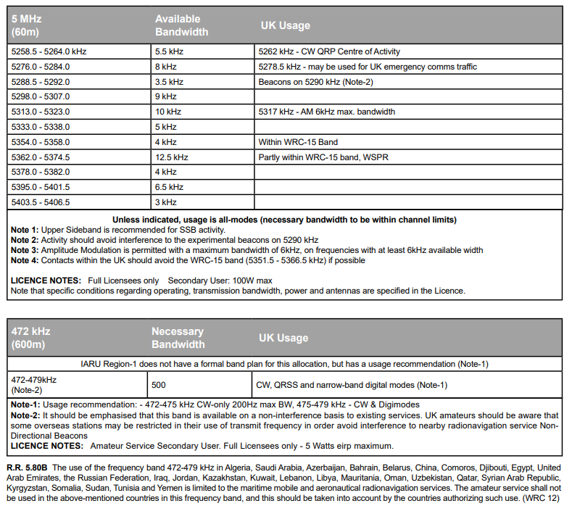
Band Plans – 472 kHz & 5 MHz

Slide 35
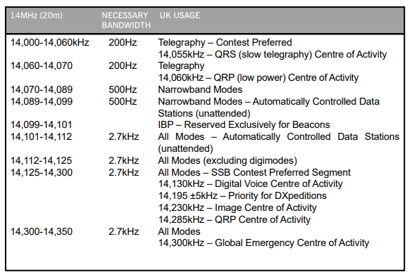
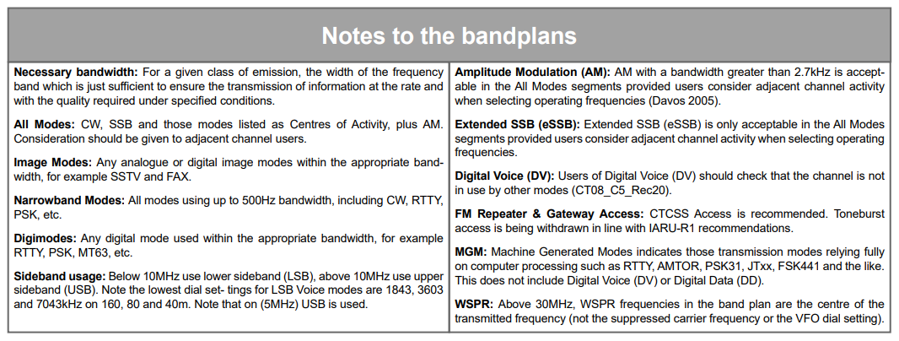
Band Plan – 14 MHz

Slide 36
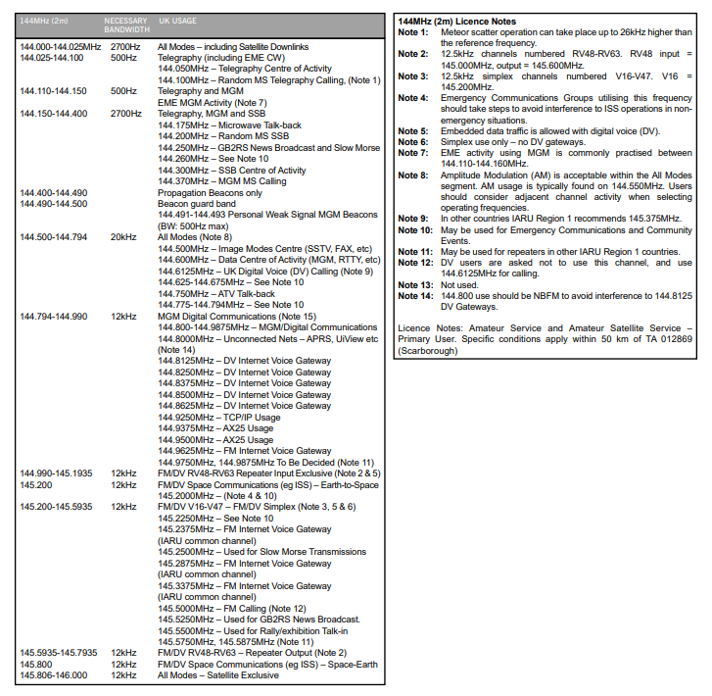
Band Plan – 144 MHz

Slide 37
Band Plans - 3
Note that band plans in other countries and IARU regions may not align with the UK band plans eg the UK (IARU Region 1) 40 metre band extends from 7.0 to 7.2 MHz but in the USA (IARU Region 2), the band is 7.0 to 7.3 MHz and hence America has a different band plan.

Slide 38
Band Plans Notes - 1
1. Narrow band modes eg CW (Morse code) and data tend to be at the lower end of the bands.
2. Lower sideband (LSB) is normally used below 10 MHz and Upper sideband (USB) above 10 MHz. One important exception is that you MUST use USB in the 5 MHz band (the frequencies are shared with the UK military and the military only use USB).

Slide 39
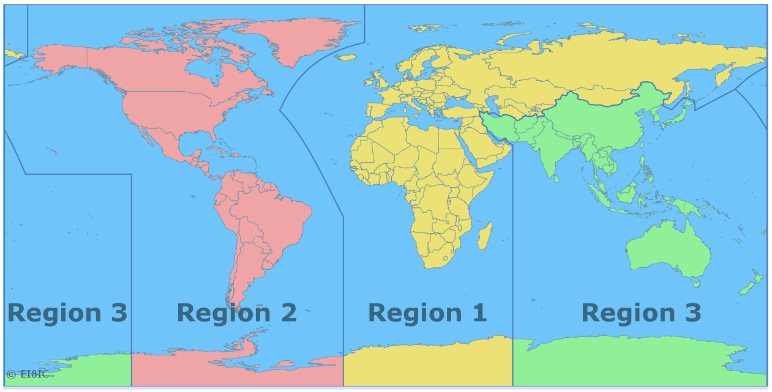
Band Plans Notes - 2

Slide 40
Band Plans Notes - 3
3. Transmission on beacon frequencies must be avoided.
4. SSB (voice) operation should not be used on the 10 MHz (30 metre band) because it is only 50 kHz wide.

Slide 41
Band Plans Notes - 4
5. Contests shall NOT be organised in the 5 MHz, 10 MHz, 18 MHz and 24 MHz bands.
6. Transmissions on satellite frequencies should be avoided for terrestrial contacts.

Slide 42
Band Plans Notes – 5
The RF spectrum is allocated to many other users. Even some amateur bands are shared with other organisations eg our seventy centimetre band (430-440 MHz) is shared with the Ministry of Defence.

Slide 43
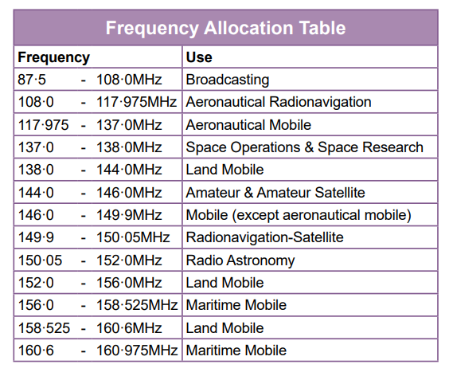
Band Plans – Other Users
A portion of the VHF spectrum

Slide 44
Repeaters

Slide 45
Repeaters
A repeater is an automatic relay station usually on a hill or high building.
Used to improve the range of mobile & hand portable stations.

Slide 46
Mobile/Portable problems
Antennas only few feet above ground
Often low power eg 4 Watts or less
Moving among buildings, trees, hills
Result – very short range

Slide 47
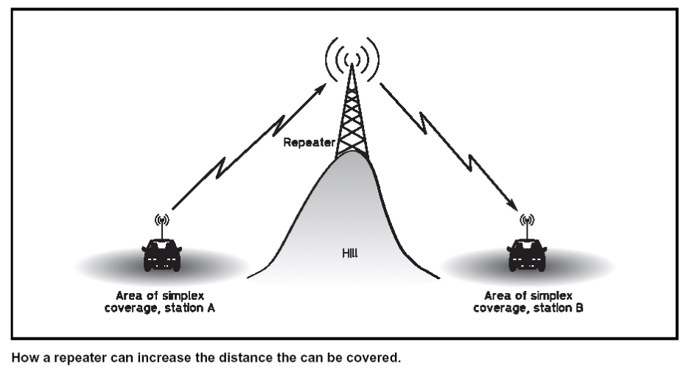
Problem – short range

Slide 48
Solution – A Repeater

Slide 49
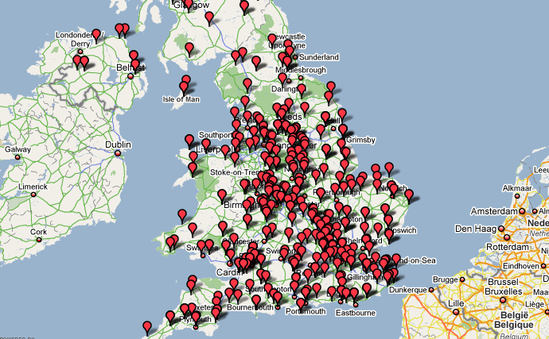
Repeaters - Map
300 +

Slide 50
Repeater Technical Issues - 1
Most repeaters have to transmit and
receive at the SAME time, from the
same location and often using the same
antenna
Therefore they must receive and
transmit on DIFFERENT
frequencies.

Slide 51
Repeater Technical Issues - 2
On 2 metres (144 MHz) the frequency
offset is 0.6 MHz eg GB3VA receives on 145.1 MHz and transmits on 145.7 MHz.
On 70 cms (430 MHz) the offset is 1.6, 7.6 or 9.0 MHz eg GB3HR receives on 434.95 MHz and transmits on 433.35 MHz.
Do NOT operate simplex transmissions on repeater input or output frequencies.

Slide 52
Repeater Technical Issues - 3
We need a system to control when a
repeater re-transmits
CTCSS – continuous tone
Nine frequencies are used by amateurs in UK:
67.1 Hz 71.9 Hz 77.0 Hz
82.5 Hz 88.5 Hz 94.8 Hz
103.9 Hz 110.9 Hz 118.8 Hz

Slide 53
Repeater Technical Issues - 4
Some repeaters have a transmit time-out eg 2 minutes.
Such repeaters often have a “reset” facility where a half second burst of tone will restart the 2 minute timer.

Slide 54
Digital Modes
In addition to analogue voice and Morse code there are now many digital modes in use.
Some convert analogue speech into digital streams (DV) and others encode text or images into data streams (DD).
The different systems may not be compatible and may need appropriate equipment eg DMR, Fusion and D-Star are all different DV systems.

Slide 55
Digital Modes - Equipment
Some DV equipment embeds a callsign into the data and, for the purposes of radio identification, this MUST be the same as the operator.
If you borrow such equipment you must reset the embedded callsign.

Slide 56
Digital Equipment- Operating
Users of DV equipment should check that a channel is not in use by another mode before transmitting.
Similarly, FM operators should check that the channel is not in use by other modes.
However, such checks are not 100% reliable.

Slide 57
Digital Equipment- Computers -1
Several types of transmissions can be generated and received with the aid of a personal computer and suitable interface.
Quite often the “interface” is little more than a few resistors and possibly two small audio transformers. The object is to connect the computer soundcard output to the transmitter microphone socket and the loudspeaker of the receiver into the soundcard line input.

Slide 58
Digital Equipment- Computers -2
It is important to get the audio levels, to and from the transceiver, correct.
Beware that computers can generate warning “bleeps.” This should be disabled to prevent unwanted transmissions.

Slide 59
Satellites

Slide 60
Satellites - Doppler
Satellites orbit the Earth at heights above 250 km and travel at 17,000 mph.
Such high speed causes signals to
shift in frequency – a few kHz up or down (Doppler shift).

Slide 61
Satellites – uplink & downlink
Most satellites orbit earth in about 90 minutes.
Only in range for 10 minutes each “pass”.
Uplink & downlink frequencies are always in
different bands eg 144 & 432 MHz.
You MUST be able to receive on BOTH uplink
and downlink frequencies.

Slide 62
Satellites – uplink & downlink
Contact via a satellite is ONLY possible when the satellite is above the horizon at BOTH the sending and receiving stations.

Slide 63
Satellites – frequencies
Satellites use fairly narrow specific sections of the amateur bands.
Terrestrial contacts should not use satellite frequencies.

Slide 64
Satellites - power
Satellites have limited power supplies.
You only need a few Watts to communicate via a satellite.
Excessive uplink power can reduce signal
strength of other users and may cause the satellite to shut down.

Slide 65
Operating - End

